Slide 1
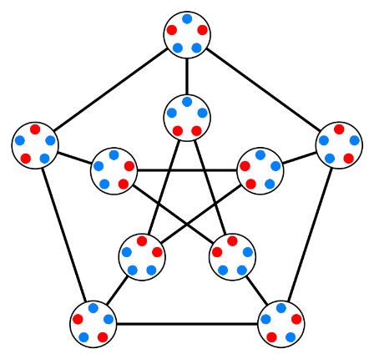

Graph Theory Basics
Mr. Asim Raza
Email: asim.raza@ucp.edu.pk

Slide 2
Let’s talk more about Graphs
TREES

Slide 3
Summary - Recap
Graph
Degree
Number of Odd-degree vertices are even
Paths
Cycles
Eulerian Graph: A graph containing Eulerian Path
Hamiltonian Graph: A graph containing Hailtonian Cycle

Slide 4
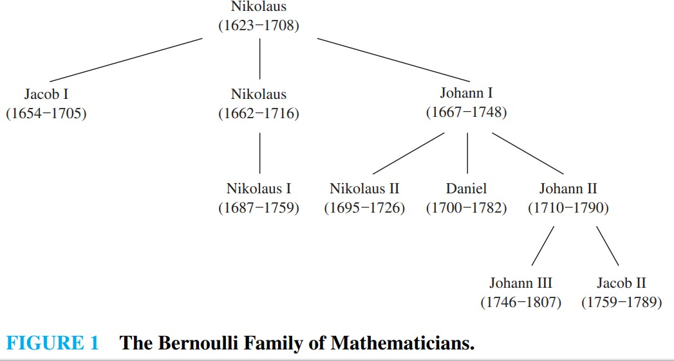
Trees (Book 1: Page 766)
A connected graph that contains no simple circuits is called a tree.

Slide 5
Applications of Trees (Book 1, Page 766)
Trees are used to construct efficient algorithms for locating items in a list.
They can be used in algorithms, such as Huffman coding, that construct efficient codes saving costs in data transmission and storage.
Trees can be used to study games such as checkers and chess and can help determine winning strategies for playing these games.
Trees can be used to model procedures carried out using a sequence of decisions. Constructing these models can help determine the computational complexity of algorithms based on a sequence of decisions, such as sorting algorithms.

Slide 6
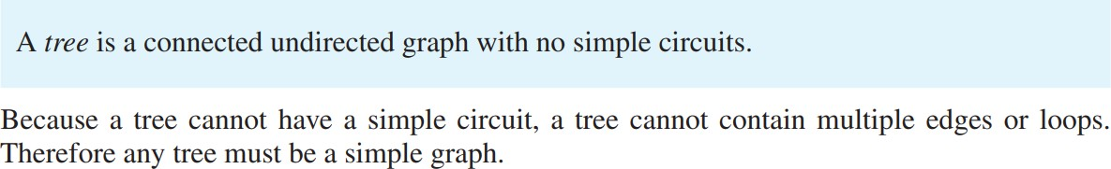
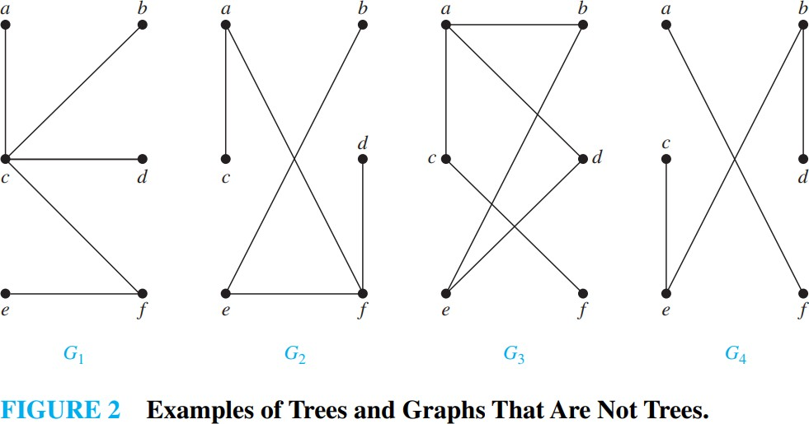
Trees
(Book 1: Page 767)
Example 1: Which of the graphs shown in Figure 2 are
trees?
Solution: G1 and G2 are trees, because both are connected graphs with no simple circuits. G3 is not a tree because e, b, a, d, e is a simple circuit in this graph. Finally, G4 is not a tree because it is not connected.

Slide 7
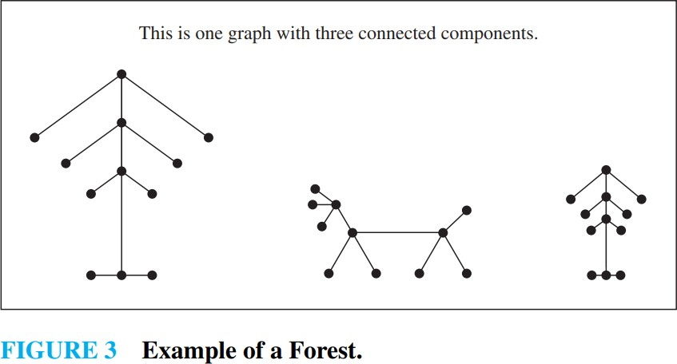
Forest (Book 1, Page 767)
Graphs containing no simple circuits that are not necessarily connected are called forest.
They have the property that each of their connected components is a tree as shown in Figure 3.

Slide 8
(Book 1, Page 767)
Tree

Slide 9
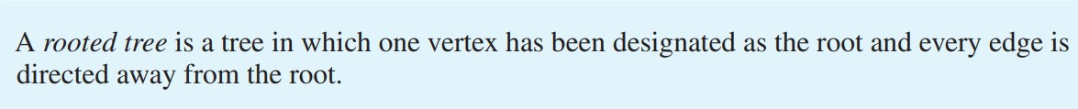
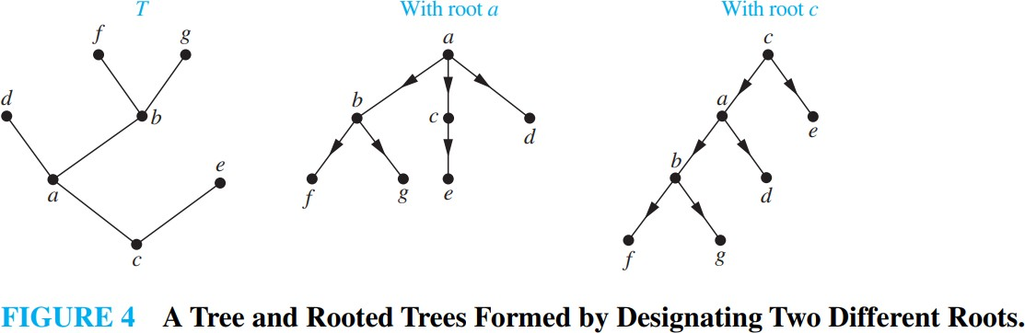
Rooted Trees
(Book 1, Page 768)
In many applications of trees, a particular vertex of a tree is designated as the root. Once we specify a root, we can assign a direction to each edge as follows. Because there is a unique path from the root to each vertex of the graph (by Theorem 1), we direct each edge away from the root. Thus, a tree together with its root produces a directed graph called a rooted tree.

Slide 10
Terminology of Trees (Book 1, Page 768)
The terminology for trees has botanical and genealogical.
Let 𝑇 be a tree with root 𝑣₀. Suppose that 𝑥, 𝑦, and 𝑧 are vertices in 𝑇 and that (𝑣₀, 𝑣₁, … , 𝑣_{𝑛}) is a simple path in 𝑇. Then
1. 𝑣_{𝑛−1} is the parent of 𝑣_{𝑛}.
2. 𝑣₀, … , 𝑣_{𝑛−1} are ancestors of 𝑣_{𝑛}.
3. 𝑣_{𝑛} is a child of 𝑣_{𝑛−1}.
If 𝑥 is an ancestor of 𝑦, 𝑦 is a descendent of 𝑥.
If 𝑥 and 𝑦 are children of 𝑧, 𝑥 and 𝑦 are siblings.
If 𝑥 has no children, 𝑥 is a terminal vertex (or a leaf).
If 𝑥 is not a terminal vertex and has children, 𝑥 is an internal (or branch) vertex.

Slide 11
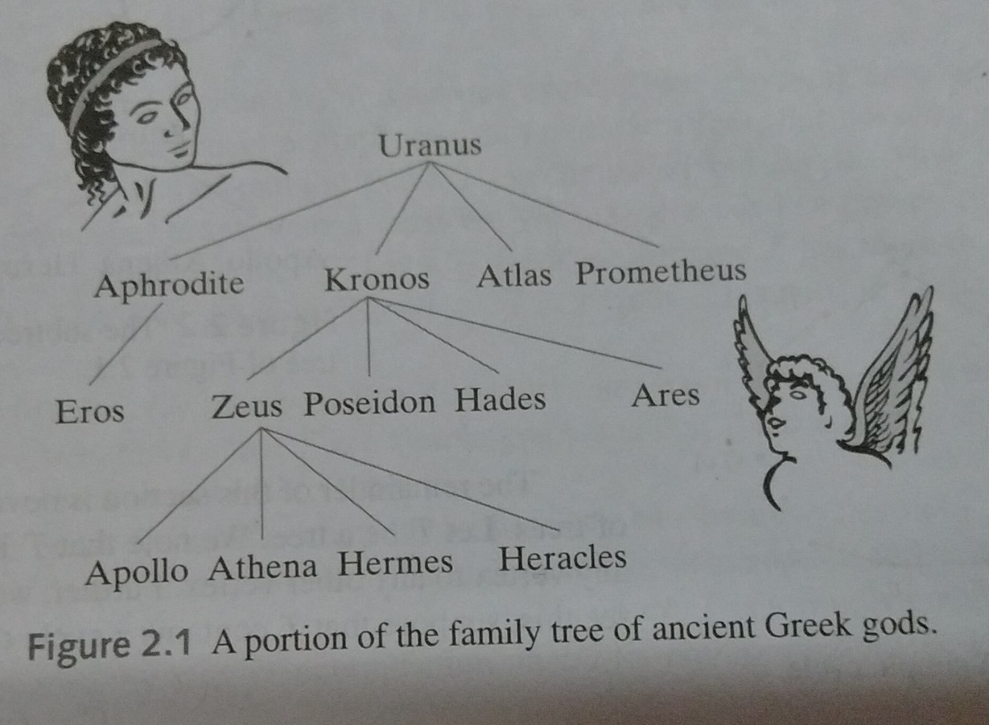
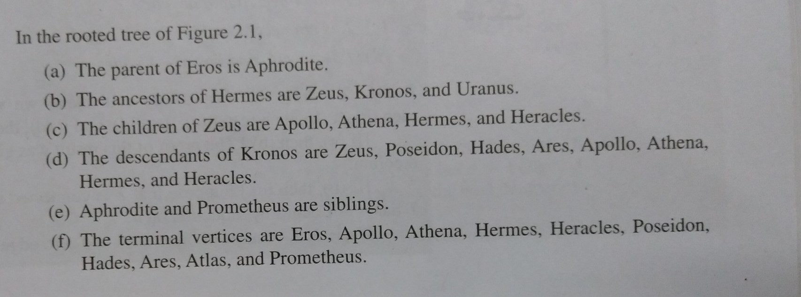
Terminology of Trees

Slide 12
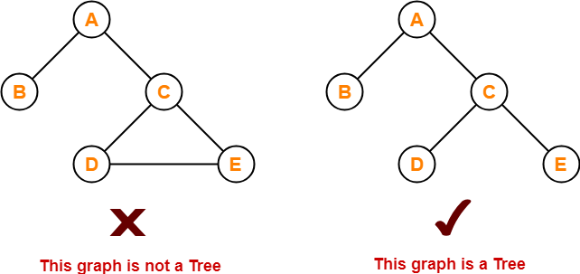
Trees

Slide 13
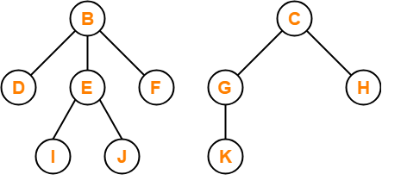
Trees - Definitions
A connected graph containing no cycles as its sub-graphs.
Connectedness: Graph cannot have too few edges
No Cycles: Graph cannot have too many edges

Slide 14
Trees - Definitions
A connected graph containing no cycles as its sub-graphs.
Connectedness: Graph cannot have too few edges
Removing any edge will make graph disconnected
No Cycles: Graph cannot have too many edges
Adding any edge will create cycle in the graph

Slide 15
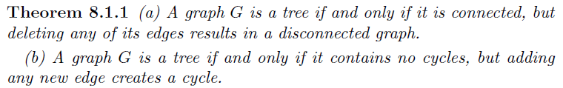
Trees - Definitions
A connected graph containing no cycles as its sub-graphs.
Connectedness: Graph cannot have too few edges
Removing any edge will make graph disconnected
No Cycles: Graph cannot have too many edges
Adding any edge will create cycle in the graph

Slide 16
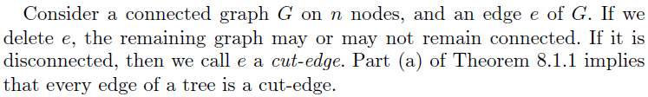
Trees - Definitions
Cut-edge is also called Bridge

Slide 17
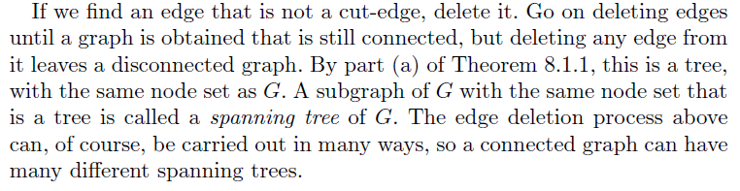
Trees - Definitions

Slide 18
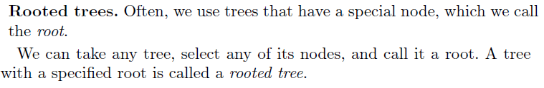
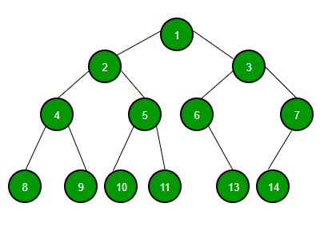
Rooted Trees

Slide 19
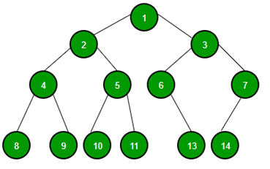
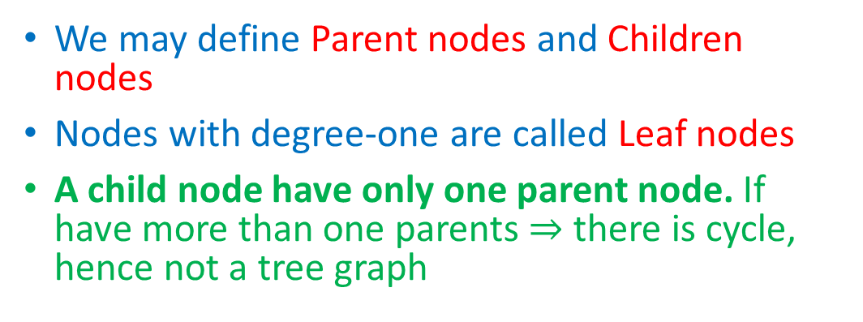
Rooted Trees
We may define Parent nodes and Children nodes
Nodes with degree-one are called Leaf nodes
A child node have only one parent node. If have more than one parents $⇒$ there is cycle, hence not a tree graph

Slide 20
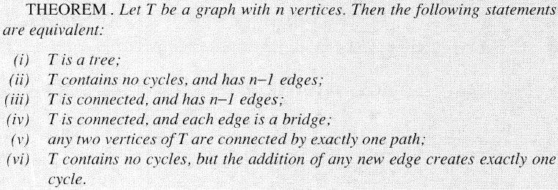
Trees – Summary of Properties

Slide 21
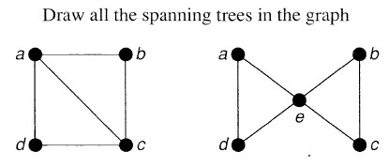
Trees - Exercise

Slide 22
How to Grow Trees – (Section 8.2 of textbook)

Slide 23
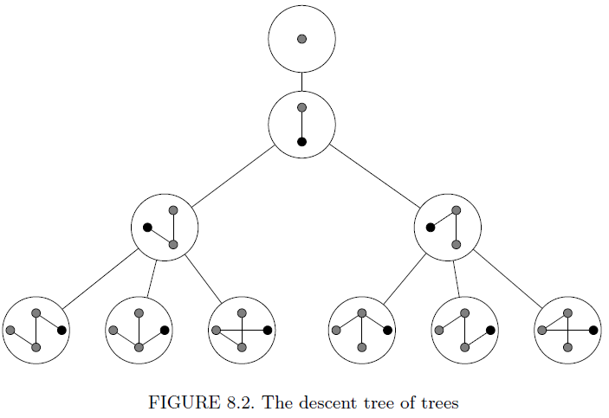
How to Grow Trees – (Section 8.2 of textbook)
Join different trees with exactly one edge between them, to expand the tree

Slide 24
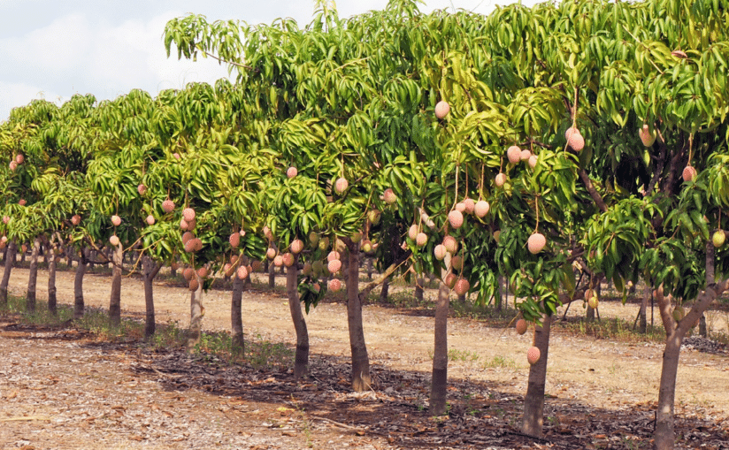
Let’s Count Trees
How many trees are there on n nodes?

Slide 25
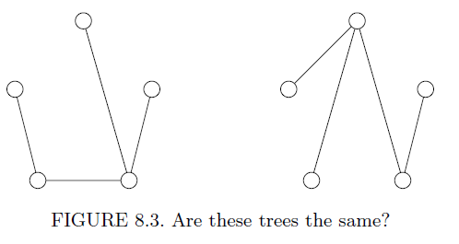
Let’s Count Trees
How many trees are there on n nodes?
Counting Labelled or Unlabeled Trees?

Slide 26
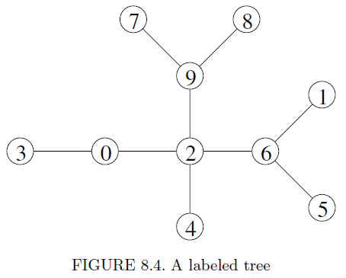
Let’s Count Trees
How many trees are there on n nodes?
Counting Labelled Trees !

Slide 27
Counting Labelled Trees

Slide 28
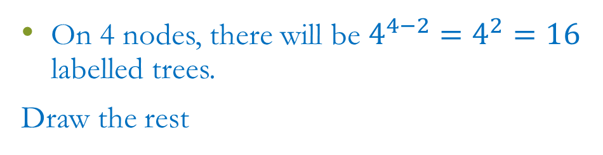
Counting Labelled Trees
On 4 nodes, there will be $4^{4−2}=4^{2}=16$ labelled trees.
Draw the rest
How many unlabeled trees will be there?
Draw all unlabeled trees.

Slide 29
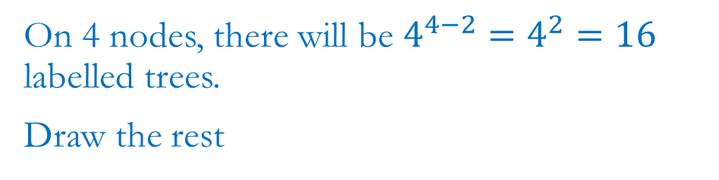
Counting Labelled Trees
On 4 nodes, there will be $4^{4−2}=4^{2}=16$ labelled trees.
Draw the rest
How many unlabeled trees will be there?
Draw all unlabeled trees.

Slide 30

Counting Labelled Trees
Draw all spanning trees for $K_{3}$ and $K_{4}$

Slide 31
Trees – Examples
Binary Trees
Depth First (DFS) and Breadth First (BFS) Trees
Red-Black Trees
AVL Trees

Slide 32
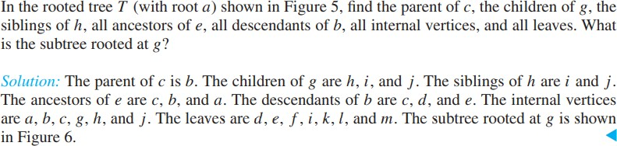
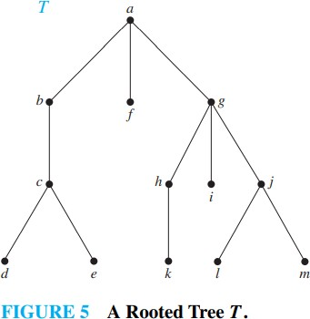
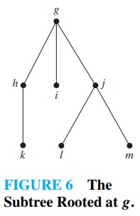
Subtree (Book 1, Page769 )
If 𝑎 is a vertex in a tree, subtree with 𝑎 as its root is the subgraph of the tree
consisting of 𝑎 and its descendants and all edges incident to these descendants.

Slide 33
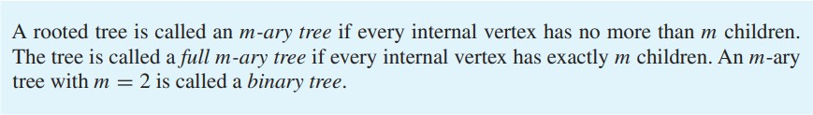
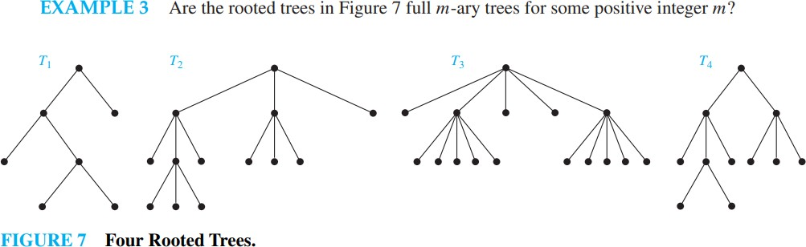
m-ary tree
(Book 1, Page 769)
𝑇₁ is full binary tree.
𝑇₂is a full 3-ary tree.
𝑇₃ is a full 5-ary tree.
𝑇₄ is not a full m-ary tree.

Slide 34
Ordered Rooted Trees (Book 1, Page 770)
An ordered rooted tree is a rooted tree where the children of each internal vertex are ordered.
Ordered rooted trees are drawn so that the children of each internal vertex are shown in order from left to right.
Note that a representation of a rooted tree in the conventional way determines an ordering for its edges.

Slide 35
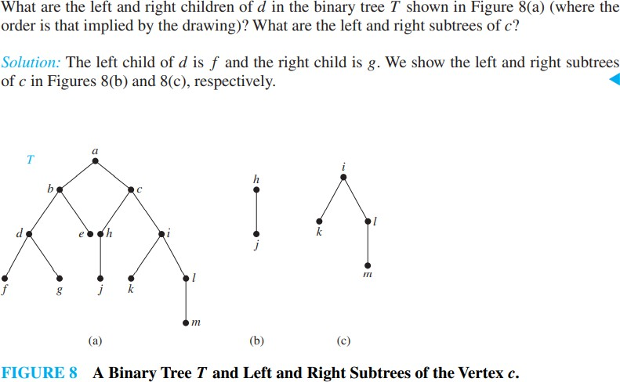
(Book 1, Page 770)
Ordered Rooted Trees

Slide 36
Binary Search Trees (Book 1, Page 778)
Searching for items in a list is one of the most important tasks that arises in computer science.
To implement a searching algorithm that finds items efficiently when the items are totally ordered.
A binary search tree, which is a binary tree in which each child of a vertex is designated as a right or left child, no vertex has more than one right child or left child, and each vertex is labeled with a key, which is one of the items.
Furthermore, vertices are assigned keys so that the key of a vertex is both larger than the keys of all vertices in its left subtree and smaller than the keys of all vertices in its right subtree

Slide 37
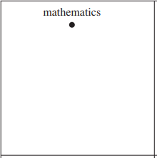
Binary Search Trees (Book 1, Page 779)
Form a binary search tree for the words mathematics, physics, geography, zoology, meteorology, geology, psychology, and chemistry (using alphabetical order).

Slide 38
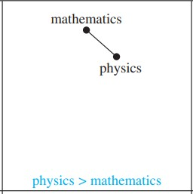
Binary Search Trees (Book 1, Page 779)
Form a binary search tree for the words mathematics, physics, geography, zoology, meteorology, geology, psychology, and chemistry (using alphabetical order).

Slide 39
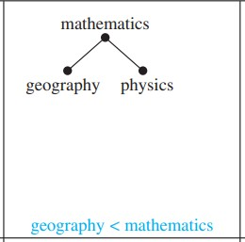
Binary Search Trees (Book 1, Page 779)
Form a binary search tree for the words mathematics, physics, geography, zoology, meteorology, geology, psychology, and chemistry (using alphabetical order).

Slide 40
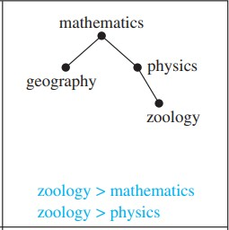
Binary Search Trees (Book 1, Page 779)
Form a binary search tree for the words mathematics, physics, geography, zoology, meteorology, geology, psychology, and chemistry (using alphabetical order).

Slide 41
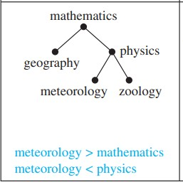
Binary Search Trees (Book 1, Page 779)
Form a binary search tree for the words mathematics, physics, geography, zoology, meteorology, geology, psychology, and chemistry (using alphabetical order).

Slide 42
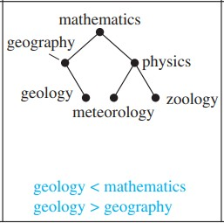
Binary Search Trees (Book 1, Page 779)
Form a binary search tree for the words mathematics, physics, geography, zoology, meteorology, geology, psychology, and chemistry (using alphabetical order).

Slide 43
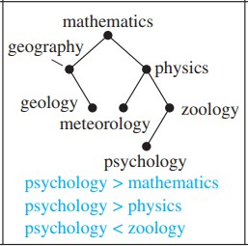
Binary Search Trees (Book 1, Page 779)
Form a binary search tree for the words mathematics, physics, geography, zoology, meteorology, geology, psychology, and chemistry (using alphabetical order).

Slide 44
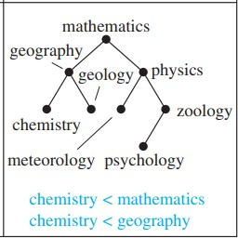
Binary Search Trees (Book 1, Page 779)
Form a binary search tree for the words mathematics, physics, geography, zoology, meteorology, geology, psychology, and chemistry (using alphabetical order).

Slide 45
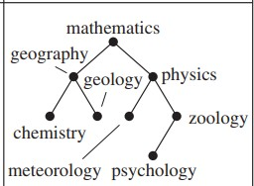
Binary Search Trees (Book 1, Page 780)
Use Algorithm 1 to insert the word oceanography into the binary search tree in Previous Example.
oceanography

Slide 46
Prefix Codes (Book 1, Page 783)
To encode letters so that the bit string for a letter never occurs as the first part of the bit string for another letter. Codes with this property are called prefix codes.
Example: the encoding of e as 0, a as 10, and t as 11 is a prefix code. A word can be recovered from the unique bit string that encodes its letters
The string 10110 is the encoding of ate.

Slide 47
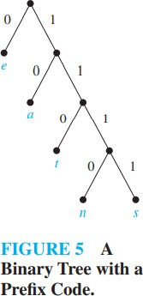
Prefix Codes (Book 1, Page 783)
A prefix code can be represented using a binary tree, where the characters are the labels of the leaves in the tree.
The tree in Figure 5 represents the encoding of e by 0, a by 10, t by 110, n by 1110, and s by 1111.
Consider the word encoded by 11111011100 using the code in Figure 5.

Slide 48
Prefix Codes (Book 1, Page 783)
A prefix code can be represented using a binary tree, where the characters are the labels of the leaves in the tree.
The tree in Figure 5 represents the encoding of e by 0, a by 10, t by 110, n by 1110, and s by 1111.
Consider the word encoded by 11111011100 using the code in Figure 5. sane

Slide 49
Tree Traversal (Book 1, Page 794)
Ordered rooted trees are often used to store information.
We need procedures for visiting each vertex of an ordered rooted tree to access data.
Procedures for systematically visiting every vertex of an ordered rooted tree are called traversal algorithms.
There are three of the most commonly used such algorithms:
Preorder traversal,
Inorder traversal, and
Postorder traversal.
Each of these algorithms can be defined recursively.

Slide 50
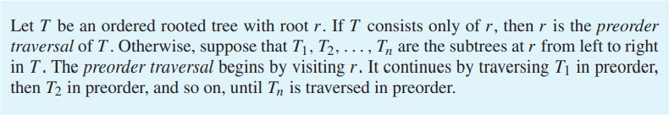
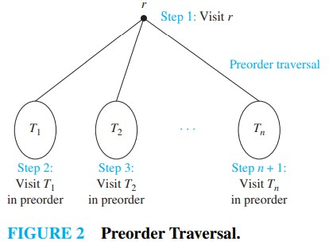
(Book 1, Page 794)
Preorder Traversal

Slide 51
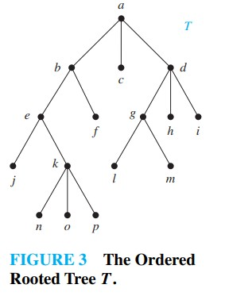
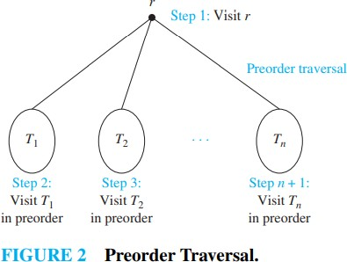
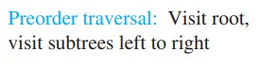
(Book 1, Page 794)
Preorder Traversal

Slide 52
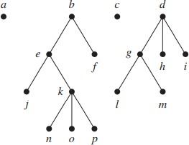
(Book 1, Page 795)
Preorder Traversal

Slide 53
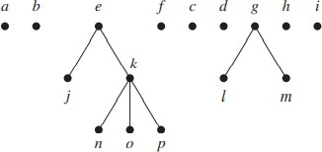
(Book 1, Page 795)
Preorder Traversal

Slide 54
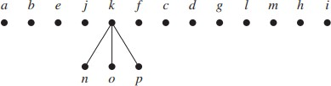
(Book 1, Page 795)
Preorder Traversal

Slide 55
(Book 1, Page 795)
Preorder Traversal

Slide 56


(Book 1, Page 796)
Preorder Traversal

Slide 57


(Book 1, Page 796)
Preorder Traversal

Slide 58

(Book 1, Page 796)
Preorder Traversal

Slide 59

(Book 1, Page 796)
Preorder Traversal

Slide 60

(Book 1, Page 796)
Preorder Traversal

Slide 61
(Book 1, Page 797)
Preorder Traversal

Slide 62


(Book 1, Page 797)
Postorder Traversal

Slide 63



(Book 1, Page 798)
Postorder Traversal

Slide 64

(Book 1, Page 799)
Postorder Traversal

Slide 65

(Book 1, Page 799)
Postorder Traversal

Slide 66

(Book 1, Page 799)
Postorder Traversal

Slide 67
(Book 1, Page 799)
Postorder Traversal

Slide 68
Shortest-Path Problems (Book 1, Page 728)
Many problems can be modeled using graphs with weights assigned to their edges.
How an airline system can be modeled. We set up the basic graph model by representing cities by vertices and flights by edges.
Problems involving distances can be modeled by assigning distances between the cities to the edge.
Problems involving flight time can be modeled by assigning flight times to edges.
Problems involving fares can be modeled by assigning fares to the edges.

Slide 69

Weighted Graphs Modeling an Airline System
Problems involving distances can be modeled by assigning distances between the cities to the edge.

Slide 70

Weighted Graphs Modeling an Airline System
1. Problems involving flight time can be modeled by assigning flight times to edges.

Slide 71

Weighted Graphs Modeling an Airline System
Problems involving fares can be modeled by assigning fares to the edges.

Slide 72


Find a shortest path from a to z. Using Dijkstra’s Algorithm (Book 1, Page 733)
_{B} 5 _{D}
4
6
Node | A | B | C | D | E | Z
Mini Distance | 0 | ∞ | ∞ | ∞ | ∞ | ∞
Previous Node
A
1
8
2
Z
2
3
C
E
10

Slide 73
Find a shortest path from a to z. Using Dijkstra’s Algorithm (Book 1, Page 733)
Node | A | B | C | D | E | Z
Mini Distance | 0 | ∞ | ∞ | ∞ | ∞ | ∞
Previous Node
B
5
D
4
6
A
1
8
2
Z
Node | A | B | C | D | E | Z
Mini Distance | 0 | 4 | 2 | ∞ | ∞ | ∞
Previous Node |  | A | A
2
C
E
3
10
L(b) = min{old L(b), L(a)+w(ab)}= {∞,0+4}= 4
L(c) = min{old L(c), L(a)+w(ac)}= {∞,0+2}= 2

Slide 74
Find a shortest path from a to z. Using Dijkstra’s Algorithm (Book 1, Page 733)
Node | A | B | C | D | E | Z
Mini Distance | 0 | 4 | 2 | ∞ | ∞ | ∞
Previous Node |  | A | A
_{B} 5 _{D}
4
6
A
8
Z
Node | A | B | C | D | E | Z
Mini Distance | 0 | 3 | 2 | 10 | 12 | ∞
Previous Node |  | C | A | C | C
1
2
2
C
E
3
10
L(b) = min{old L(b), L(c)+w(cb)}= {4,2+1}=3
L(d) = min{old L(d), L(c)+w(cd)}= {∞,2+8}=10
L(e) = min{old L(e), L(c)+w(ce)}= {∞,2+10}=12

Slide 75
Find a shortest path from a to z. Using Dijkstra’s Algorithm (Book 1, Page 733)
Node | A | B | C | D | E | Z
Mini Distance | 0 | 3 | 2 | 10 | 12 | ∞
Previous Node |  | C | A | C | C
B
5
D
6
4
Node | A | B | C | D | E | Z
Mini Distance | 0 | 3 | 2 | 8 | 12 | ∞
Previous Node |  | C | A | B | C
A
1
8
2
Z
2
3
C
E
10
L(d) = min{old L(d), L(b)+w(bd)}= {10,3+5}=8

Slide 76
Find a shortest path from a to z. Using Dijkstra’s Algorithm (Book 1, Page 733)
Node | A | B | C | D | E | Z
Mini Distance | 0 | 3 | 2 | 8 | 12 | ∞
Previous Node |  | C | A | B | C
_{B} 5 _{D}
4
6
A
1
8
2
Z
Node | A | B | C | D | E | Z
Mini Distance | 0 | 3 | 2 | 8 | 10 | 14
Previous Node |  | C | A | B | D | D
2
C
E
3
10
L(e) = min{old L(e), L(d)+w(de)}= {12,8+2}=10
L(z) = min{old L(z), L(d)+w(dz)}= {∞,8+6}=14

Slide 77
Find a shortest path from a to z. Using Dijkstra’s Algorithm (Book 1, Page 733)
Node | A | B | C | D | E | Z
Mini Distance | 0 | 3 | 2 | 8 | 10 | 14
Previous Node |  | C | A | B | D | D
B
5
D
4
6
Node | A | B | C | D | E | Z
Mini Distance | 0 | 3 | 2 | 8 | 10 | 13
Previous Node |  | C | A | B | D | E
A
1
8
2
Z
2
3
C
E
10
L(z) = min{old L(z), L(e)+w(ez)}= {14,10+3}=13

Slide 78
Find a shortest path from a to z. Using Dijkstra’s Algorithm (Book 1, Page 733)
_{B} 5 _{D}
4
6
Node | A | B | C | D | E | Z
Mini Distance | 0 | 3 | 2 | 8 | 10 | 13
Previous Node |  | C | A | B | D | E
A
1
8
2
Z
2
3
C
E
10
The shortest path from a to z is a,c,b,d,e,z with length 13.

Slide 79



Slide 80
Cayley’s Formula – How to Store the Trees
How to store this tree in computer?
We want to store the tree so it should use least memory

Slide 81


How to Store the Trees – 1: Adjacency Matrix
How to store this tree in computer?
We want to store the tree so it should use least memory
One solution could be to store the adjacency matrix … not an optimal way --- consuming $n^{2}$ bits

Slide 82


How to Store the Trees – 1: Adjacency Matrix
Adjacency Matrix
$\begin{matrix}\begin{aligned}Cols \\ Rows\end{aligned} & 1 & 2 & 3 & 4 & 5 & 6 & 7 & 8 & 9 & 0\end{matrix}$
$$\begin{matrix}1 \\ \begin{aligned}2 \\ 3 \\ 4 \\ 5 \\ 6 \\ 7 \\ 8 \\ 9 \\ 0\end{aligned} \end{matrix}\left[\begin{matrix}0 & 0 & 0 & 0 & 0 & 1 & 0 & 0 & 0 & 0 \\ 0 & 0 & 0 & 1 & 0 & 1 & 0 & 0 & 1 & 1 \\ 0 & 0 & 0 & 0 & 0 & 0 & 0 & 0 & 0 & 1 \\ 0 & 1 & 0 & 0 & 0 & 0 & 0 & 0 & 0 & 0 \\ 0 & 0 & 0 & 0 & 0 & 1 & 0 & 0 & 0 & 0 \\ 1 & 1 & 0 & 0 & 1 & 0 & 0 & 0 & 0 & 0 \\ 0 & 0 & 0 & 0 & 0 & 0 & 0 & 0 & 1 & 0 \\ 0 & 0 & 0 & 0 & 0 & 0 & 0 & 0 & 1 & 0 \\ 0 & 1 & 0 & 0 & 0 & 0 & 1 & 1 & 0 & 0 \\ 0 & 1 & 1 & 0 & 0 & 0 & 0 & 0 & 0 & 0\end{matrix}\right]$$
One solution could be to store the adjacency matrix …
not an optimal way ---
consuming $n^{2}$ bits

Slide 83

How to Store the Trees – 1: Adjacency Matrix
Adjacency Matrix
$\begin{matrix}\begin{aligned}Cols \\ Rows\end{aligned} & 1 & 2 & 3 & 4 & 5 & 6 & 7 & 8 & 9 & 0\end{matrix}$
$$\begin{matrix}1 \\ \begin{aligned}2 \\ 3 \\ 4 \\ 5 \\ 6 \\ 7 \\ 8 \\ 9 \\ 0\end{aligned} \end{matrix}\left[\begin{matrix}0 & 0 & 1 & 0 & 0 & 0 & 0 & 0 & 0 & 0 \\ 0 & 0 & 0 & 1 & 0 & 1 & 0 & 0 & 1 & 1 \\ 0 & 0 & 0 & 0 & 0 & 0 & 0 & 0 & 0 & 1 \\ 0 & 1 & 0 & 0 & 0 & 0 & 0 & 0 & 0 & 0 \\ 0 & 0 & 0 & 0 & 0 & 1 & 0 & 0 & 0 & 0 \\ 1 & 1 & 0 & 0 & 1 & 0 & 0 & 0 & 0 & 0 \\ 0 & 0 & 0 & 0 & 0 & 0 & 0 & 0 & 1 & 0 \\ 0 & 0 & 0 & 0 & 0 & 0 & 0 & 0 & 1 & 0 \\ 0 & 1 & 0 & 0 & 0 & 0 & 1 & 1 & 0 & 0 \\ 0 & 0 & 1 & 1 & 0 & 0 & 0 & 0 & 0 & 0\end{matrix}\right]$$
No need to store the diagonal --- it is always ZERO
One solution could be to store the adjacency matrix …
not an optimal way ---
consuming $n^{2}$ bits

Slide 84


How to Store the Trees – 1: Adjacency Matrix
Adjacency Matrix
$\begin{matrix}\begin{aligned}Cols \\ Rows\end{aligned} & 1 & 2 & 3 & 4 & 5 & 6 & 7 & 8 & 9 & 0\end{matrix}$
$$\begin{matrix}1 \\ \begin{aligned}2 \\ 3 \\ 4 \\ 5 \\ 6 \\ 7 \\ 8 \\ 9 \\ 0\end{aligned} \end{matrix}\left[\begin{matrix}0 & 0 & 1 & 0 & 0 & 0 & 0 & 0 & 0 & 0 \\ 0 & 0 & 0 & 1 & 0 & 1 & 0 & 0 & 1 & 1 \\ 0 & 0 & 0 & 0 & 0 & 0 & 0 & 0 & 0 & 1 \\ 0 & 1 & 0 & 0 & 0 & 0 & 0 & 0 & 0 & 0 \\ 0 & 0 & 0 & 0 & 0 & 1 & 0 & 0 & 0 & 0 \\ 1 & 1 & 0 & 0 & 1 & 0 & 0 & 0 & 0 & 0 \\ 0 & 0 & 0 & 0 & 0 & 0 & 0 & 0 & 1 & 0 \\ 0 & 0 & 0 & 0 & 0 & 0 & 0 & 0 & 1 & 0 \\ 0 & 1 & 0 & 0 & 0 & 0 & 1 & 1 & 0 & 0 \\ 0 & 0 & 1 & 1 & 0 & 0 & 0 & 0 & 0 & 0\end{matrix}\right]$$
No need to store the diagonal --- it is always ZERO
No need to store lower half triangle … it is same as upper half.
Now, we store $\frac{\left(n^{2}−n\right)}{2}$ bits
One solution could be to store the adjacency matrix …
not an optimal way ---
consuming $n^{2}$ bits

Slide 85
How to Store the Trees – 2: Store Edges
Let’s try to optimize …
We list down all edges (corresponding vertices) in two rows:

Slide 86
How to Store the Trees – 2: Store Edges
Let’s try to optimize …
We list down all edges (corresponding vertices) in two rows:

Slide 87

How to Store the Trees – 2: Store Edges
Let’s try to optimize …
We list down all edges (corresponding vertices) in two rows:
So whole table will contain $2n\log_{2}{n}$ bits
Maximum 2n entries in 2 rows and $\log_{2}{n}$ bits for each entry.

Slide 88


How to Store the Trees – 2: Store Edges
Let’s try to optimize …
We list down all edges (corresponding vertices) in two rows:
So whole table ill contain $2n\log_{2}{n}$ bits
Maximum 2n entries in 2 rows and $\log_{2}{n}$ bits for each entry.
$2n\log_{2}{n}$ vs $n^{2}$

Slide 89

How to Store the Trees – 3: Father Code
We can still do better …???
We keep record of parent and child nodes
First row: List of Child Nodes
Second row: Corresponding Parent nodes
Child Node
Father Node

Slide 90

How to Store the Trees – 3: Father Code
Possible Father Codes … $n^{n−1}$
We keep record of parent and child nodes
First row: List of Child Nodes
Second row: Corresponding Parent nodes
Child Node
Father Node

Slide 91

How to Store the Trees – 4: Prufer Code
We can still do better … ???
Prufer Code gives $n^{n−2}$ possible trees
How will it work?

Slide 92


How to Store the Trees – 4: Prufer Code
Prufer Code gives $n^{n−2}$ possible trees
How will it work?
Again make a list of parent-child nodes, but in a different way.
Again make node–0, as the root node.
We pick up an end-node (degree 1) with smallest label. (here it is node–1). Record its parent node.

Slide 93


How to Store the Trees – 4: Prufer Code
Prufer Code gives $n^{n−2}$ possible trees
How will it work?
Again make a list of parent-child nodes, but in a different way.
Again make node–0, as the root node.
We pick up an end-node (degree 1) with smallest label. (here it is node–1). Record its parent node.
Now delete this node and edge, and repeat the above step.

Slide 94


How to Store the Trees – 4: Prufer Code
Prufer Code gives $n^{n−2}$ possible trees
How will it work?
Again make a list of parent-child nodes, but in a different way.
Again make node–0, as the root node.
We pick up an end-node (degree 1) with smallest label. (here it is node–1). Record its parent node.
Now delete this node and edge, and repeat the above step.
Keep on repeating till we reach till node–0.

Slide 95
How to Store the Trees – 4: Prufer Code
Prufer Code gives $n^{n−2}$ possible trees
How will it work?
Again make a list of parent-child nodes, but in a different way.
Again make node–0, as the root node.
We pick up an end-node (degree 1) with smallest label. (here it is node–1). Record its parent node.
Now delete this node and edge, and repeat the above step.
Keep on repeating till we reach till node–0.

Slide 96
How to Store the Trees – 4: Prufer Code
Prufer Code gives $n^{n−2}$ possible trees
How will it work?
Again make a list of parent-child nodes, but in a different way.
Again make node–0, as the root node.
We pick up an end-node (degree 1) with smallest label. (here it is node–1). Record its parent node.
Now delete this node and edge, and repeat the above step.
Keep on repeating till we reach till node–0.

Slide 97
How to Store the Trees – 4: Prufer Code
Prufer Code gives $n^{n−2}$ possible trees
How will it work?
Again make a list of parent-child nodes, but in a different way.
Again make node–0, as the root node.
We pick up an end-node (degree 1) with smallest label. (here it is node–1). Record its parent node.
Now delete this node and edge, and repeat the above step.
Keep on repeating till we reach till node–0.

Slide 98
How to Store the Trees – 4: Prufer Code
Prufer Code gives $n^{n−2}$ possible trees
How will it work?
Again make a list of parent-child nodes, but in a different way.
Again make node–0, as the root node.
We pick up an end-node (degree 1) with smallest label. (here it is node–1). Record its parent node.
Now delete this node and edge, and repeat the above step.
Keep on repeating till we reach till node–0.

Slide 99
How to Store the Trees – 4: Prufer Code
Prufer Code gives $n^{n−2}$ possible trees
How will it work?
Again make a list of parent-child nodes, but in a different way.
Again make node–0, as the root node.
We pick up an end-node (degree 1) with smallest label. (here it is node–1). Record its parent node.
Now delete this node and edge, and repeat the above step.
Keep on repeating till we reach till node–0.

Slide 100
How to Store the Trees – 4: Prufer Code
Prufer Code gives $n^{n−2}$ possible trees
How will it work?
Again make a list of parent-child nodes, but in a different way.
Again make node–0, as the root node.
We pick up an end-node (degree 1) with smallest label. (here it is node–1). Record its parent node.
Now delete this node and edge, and repeat the above step.
Keep on repeating till we reach till node–0.

Slide 101

How to Store the Trees – 4: Prufer Code
Prufer Code gives $n^{n−2}$ possible trees
How will it work?
We do not need to store the last column … as it is understood the parent node is the root node (node–0 ).
So we store $n−2$columns.
Each entry may take any of the $n$ values.
So possible trees are $n^{n−2} −$ Cayley’s theorem

Slide 102

How to Store the Trees – 4: Prufer Code
Prufer Code: Decoding Example
This is list of Parent nodes.
For the 1st child, look for the missing nodes … take the least of these missing nodes.
5, 6, 7 are missing … So we pick 5 as child of 2 (the first entry)

Slide 103

How to Store the Trees – 4: Prufer Code
Prufer Code: Decoding Example
This is list of Parent nodes.
For the 1st child, look for the missing nodes … take the least of these missing nodes.
5, 6, ,7 are missing … So we pick 5 as child of 2 (the first entry)
Child Node
Father Node

Slide 104

How to Store the Trees – 4: Prufer Code
Prufer Code: Decoding Example
We are done with 5.
Next, 2, 6 ,7 are missing in the list … So we pick 2 as child of 4 (the next entry in the list)
Child Node
Father Node

Slide 105

How to Store the Trees – 4: Prufer Code
Prufer Code: Decoding Example
We are done with 5 and 2 as children.
Next, 4, 6, ,7 are missing in the list … So we pick 4 as child of 0 (the next entry in the list).
Child Node
Father Node

Slide 106

How to Store the Trees – 4: Prufer Code
Prufer Code: Decoding Example
We are done with 5, 2 and 4 as children.
Next, 6, 7 are missing in the list … So we pick 6 as child of 3 (the next entry in the list).
Child Node
Father Node

Slide 107

How to Store the Trees – 4: Prufer Code
Prufer Code: Decoding Example
We are done with 5, 2, 4 and 6 as children.
Next, 7 is missing in the list … So we pick 7 as child of 3 (the next entry in the list).
Child Node
Father Node

Slide 108

How to Store the Trees – 4: Prufer Code
Prufer Code: Decoding Example
We are done with 5, 2, 4, 6 and 7 as children.
Next, 3 is missing in the list … So we pick 3 as child of 1 (the next entry in the list).
Child Node
Father Node

Slide 109

How to Store the Trees – 4: Prufer Code
Prufer Code: Decoding Example
We are done with 5, 2, 4, 6, 7 and 3 as children.
Next, only 1 is missing in the list … So we pick 1 as child of 0 (the next entry in the list).
Child Node
Father Node

Slide 110


How to Store the Trees – 4: Prufer Code
Prufer Code: Decoding Example
We can construct the tree with these edges.
Child Node
Father Node

Slide 111

Trees - Exercises

Slide 112
How to Store the Unlabeled Trees
How many unlabeled trees are there on 1,2,3,4 nodes?
On 4 nodes, it is path and star

Slide 113


How to Store the Unlabeled Trees
How many unlabeled trees are there on 1,2,3,4 nodes?
On 4 nodes, it is path and star
Much less than Cayley’s theorem ($n^{n−2}$)

Slide 114

How to Store the Unlabeled Trees
How many unlabeled trees are there on 1,2,3,4 nodes?
On 4 nodes, it is path and star
Much less than Cayley’s theorem ($n^{n−2}$)

Slide 115
How to Store the Unlabeled Trees
How many unlabeled trees are there on 1,2,3,4 nodes?
On 4 nodes, it is path and star
Much less than Cayley’s theorem ($n^{n−2}$)

Slide 116

How to Store the Unlabeled Trees
Much less than Cayley’s theorem ($n^{n−2}$)
Unlabeled trees should be more than $\frac{n^{n−2}}{n!}$
How to store these?

Slide 117

How to Store the Unlabeled Trees
How to store these?
Let’s walk along the tree and keep record:
From root node,
Going away, mark 1
Going back towards root node mark 0.

Slide 118

How to Store the Unlabeled Trees
How to store these?
Let’s walk along the tree and keep record:
From root node,
Going away, mark 1
Going back towards root node mark 0.

Slide 119

How to Store the Unlabeled Trees
How many possible?
Binary string of Length = $2\left(n−1\right)$
Possible bit strings = $2^{2\left(n−1\right)}$ - But we must have equal number of 1s and 0s
Possible trees will be less than: maximum $2^{2\left(n−1\right)}=4^{n−1}$

Slide 120


How to Store the Unlabeled Trees
Unlabeled trees should be more than $\frac{n^{n−2}}{n!}$
How many possible?
Length = $2\left(n−1\right)$
Possible trees: maximum $2^{2\left(n−1\right)}=4^{n−1}$

Slide 121
How to Store the Unlabeled Trees
Unlabeled trees should be more than $\frac{n^{n−2}}{n!}$
How many possible?
Length = $2\left(n−1\right)$
Possible trees: maximum $2^{2\left(n−1\right)}=4^{n−1}$

Slide 122

Trees - Exercises

